Slide 1
Doubly Linked List
Presented By
MUNIESWARAN

Slide 2
Why We need?
Insertion is clearly less work in a singly-linked list, as long as you are content to always insert at the head or after some known element. (That is, you cannot insert before a known element, but see below.)
Deletion, on the other hand, is trickier because you need to know the element before the element to be deleted.

Slide 3
Where we Use?
In many operating systems, the thread scheduler (the thing that chooses what processes need to run at which times) maintains a doubly-linked list of all the processes running at any time. This makes it easy to move a process from one queue (say, the list of active processes that need a turn to run) into another queue (say, the list of processes that are blocked and waiting for something to release them). The use of a doubly-linked list here allows each of these splices and rewires to run in time O(1) and without any memory allocations
Other real time implementation:
- A music player which has next and prev buttons.
- Represent a deck of cards in a game.
- The browser cache which allows you to hit the BACK-FORWARD pages.
- Applications that have a Most Recently Used list (a linked list of file names)
- Undo-Redo functionality

Slide 4
More ..
You have ready access\insert on both ends.
it can work as a Queue and a Stack at the same time.
Node deletion requires no additional pointers.
If you are storing Numerical values, and your list is sorted, you can keep a pointer/variable for median, then Search operation can be highly optimal using Statistical approach.

Slide 5
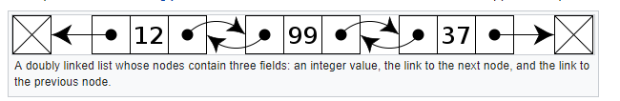
Doubly Linked List
Doubly linked list is a linked data structure that consists of a set of sequentially linked records called nodes.
Each node contains two fields, called links, that are references to the previous and to the next node in the sequence of nodes. The beginning and ending nodes' previous and next links

Slide 6
How it works
The first and last nodes of a doubly linked list are immediately accessible (i.e., accessible without traversal, and usually called head and tail)
Which will allow traversal of the list from the beginning or end of the list, respectively: e.g., traversing the list from beginning to end, or from end to beginning (during searching)
Any node of a doubly linked list, once obtained, can be used to begin a new traversal of the list, in either direction (towards beginning or end), from the given node.

Slide 7
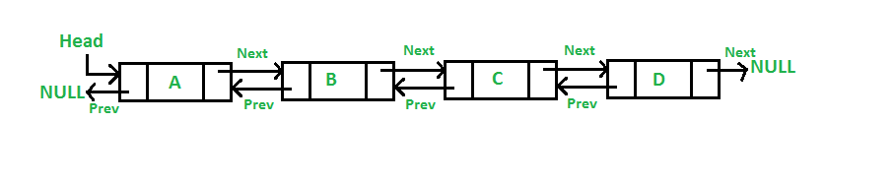

Insertion of node in DDL
A Doubly Linked List (DLL) contains an extra pointer, typically called previous pointer, together with next pointer and data which are there in singly linked list.

Slide 8
Insertion of node in DDL cont..
// Class for Doubly Linked List public class DLL { Node head; // head of list /* Doubly Linked list Node*/ class Node { int data; Node prev; Node next; // Constructor to create a new node // next and prev is by default initialized as null Node(int d){data=d;} } }

Slide 9
Add a node at front
Add a node at the front: ( 5 steps process)
The new node is always added before the head of the given Linked List. And newly added node becomes the new head of DLL. For example if the given Linked List is 10152025 and we add an item 5 at the front, then the Linked List becomes 510152025. Let us call the function that adds at the front of the list is push(). The push() must receive a pointer to the head pointer, because push must change the head pointer to point to the new node

Slide 10
//Adding a node at the front of the list
public void push(int new_data)
{
/* 1. allocate node
* 2. put in the data */
Node new_Node = new Node(new_data);
/* 3. Make next of new node as head and previous as NULL */
new_Node.next = head;
new_Node.prev = null;
/* 4. change prev of head node to new node */
if(head != null)
head.prev = new_Node;
/* 5. move the head to point to the new node */
head = new_Node;
}

Slide 11
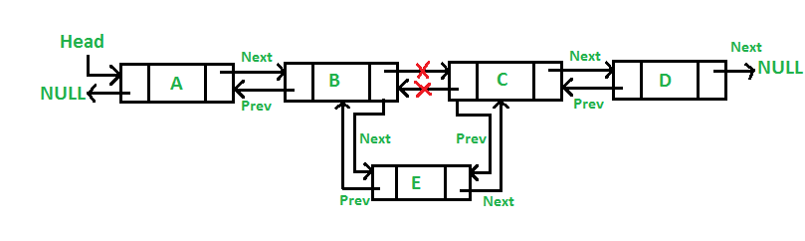
Add a node after given node:
2) Add a node after a given node.: (A 7 steps process)
We are given pointer to a node as prev_node, and the new node is inserted after the given node.

Slide 12
/* Given a node as prev_node, insert a new node after the given node */
public void InsertAfter(Node prev_Node,int new_data)
{
/*1. check if the given prev_node is NULL */
if(prev_Node == null)
{
System.out.println("The given previous node cannot be NULL ");
return;
}
/* 2. allocate node
* 3. put in the data */
Node new_node = new Node(new_data);
/* 4. Make next of new node as next of prev_node */
new_node.next = prev_Node.next;
/* 5. Make the next of prev_node as new_node */
prev_Node.next = new_node;
/* 6. Make prev_node as previous of new_node */
new_node.prev = prev_Node;
/* 7. Change previous of new_node's next node */
if(new_node.next != null)
new_node.next.prev = new_node;
}

Slide 13
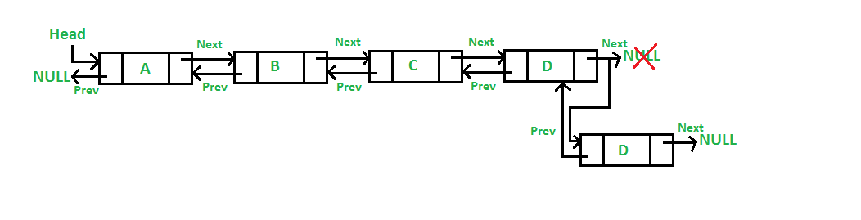
Add a node at the end
Add a node at the end: (7 steps process)
The new node is always added after the last node of the given Linked List. For example if the given DLL is 510152025 and we add an item 30 at the end, then the DLL becomes 51015202530. Since a Linked List is typically represented by the head of it, we have to traverse the list till end and then change the next of last node to new node.

Slide 14
//Add a node at the end of the list
void append(int new_data)
{
/* 1. allocate node
* 2. put in the data */
Node new_node = new Node(new_data);
Node last = head;/* used in step 5*/
/* 3. This new node is going to be the last node, so
* make next of it as NULL*/
new_node.next = null;
/* 4. If the Linked List is empty, then make the new
* node as head */
if(head == null)
{
new_node.prev = null;
head = new_node;
return;
}
/* 5. Else traverse till the last node */
while(last.next != null)
last = last.next;
/* 6. Change the next of last node */
last.next = new_node;
/* 7. Make last node as previous of new node */
new_node.prev = last;
}

Slide 15
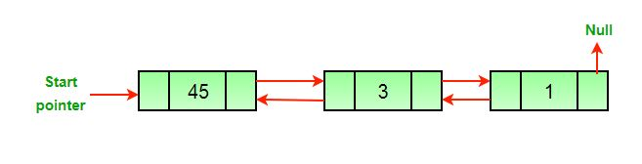
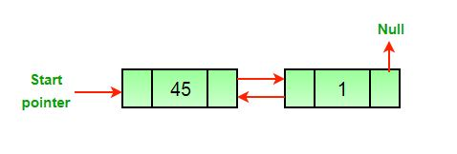
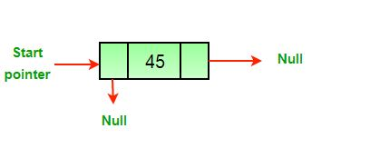
Delete a node in a Doubly Linked List

Slide 16
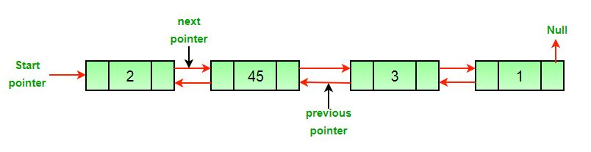
Delete node in Doubly Linked List
Algorithm Let the node to be deleted is del.
1) If node to be deleted is head node, then change the head pointer to next current head. 2) Set next of previous to del, if previous to del exist. 3) Set prev of next to del, if next to del exist.

Slide 17
Let see few program...
Doubly Linked list Insertion
Doubly Linked list Deletion
Thanks

